Slide 1
LESSON 31

Slide 2
Course
Revision

Slide 3
Contents
Compilers
Compilers Vs Interpreters
Structure of Compiler
Compilation Phases
Compiler Construction Tools
A Simple Syntax Directed Translation
Syntax Directed Translator
Attributes
Lexical Analyzer
Parsing
Intermediate Code
Symbol Table

Slide 4
Contents..
Lexical Analysis
Our Compiler Structure
Tokens, Lexemes & Patterns
RE’s & Regular Definitions
Transition Diagrams
Finite Automata
DFA & NFA

Slide 5
Compilers
A program must be translated into a form in which it can be executed by a computer.
The software systems that do this translation are called compilers.
Program in Source Language
Program in Target Language
Compiler
Errors

Slide 6
Compilers..
Language Processors An integrated software development environment includes many different kinds of language processors such as compilers, interpreters, assemblers, linkers, loaders, debuggers, profilers.
An Interpreter appears to directly execute the program and provide output.
Source Program
Interpreter
Output
Input
Error Messages

Slide 7
Compiler Vs Interpreter
Compiler Vs Interpreter
Pros
Less space
Fast execution
Cons
Slow processing
Partly Solved (Separate compilation)
Debugging
Improved thru IDEs
Pros
Easy debugging
Fast Development
Cons
Not for large projects
Requires more space
Slower execution
Interpreter in memory all the time

Slide 8
Compiler Structure
Language Processing System
Source Program
Interpreter
Modified Source Program
Compiler
Target Assembly Program
Assembler
Relocatable Machine Code
Library File Relocatable Object Files
Target Machine Code
Linker / Loader

Slide 9
Compiler Structure..
Structurally, Compiler can be divided into two parts
Analysis determines the operations implied by the source program which are recorded in a tree structure.
Synthesis takes the tree structure and translates the operations therein into the target program.

Slide 10
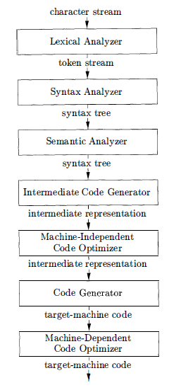
Compilation Phases
A typical decomposition of a compiler can be done into several phases.
Symbol Table
Notes:
The symbol table, which stores information about the entire source program, is used by all phases of the compiler.

Slide 11
Compiler Construction Tools
The compiler programmer can use modern software development environments containing tools such as language editors, debuggers, version managers , and so on including some specialized tools.
Parser generators automatically produce syntax analyzers from a grammatical description of a programming language.
Scanner generators produce lexical analyzers from a regular-expression description of the tokens of a language.
Syntax-directed translation engines produce collections of routines for walking a parse tree and generating intermediate code.

Slide 12
Compiler Construction Tools..
Code-generators produce a code from a collection of rules for translating each operation of the intermediate language into the machine language for a target machine.
Data-flow analysis engines facilitate the gathering of information about how values are transmitted from one part of a program to each other part.
Compiler- construction toolkits provide an integrated set of routines for constructing various phases of a compiler.

Slide 13
Compilers…
Machine and Assembly Languages
Machine languages were the first generation programming languages, followed by assembly languages.
Programming in these languages was time consuming and error prone.
Modeling in Compiler Design
Compiler design is one of the places where theory has had the most impact on practice.
Models that have been found useful include automata, grammars, regular expressions, trees, and many others.

Slide 14
Compilers…
Code Optimization
Optimization is to produce code that is more efficient than the obvious code.
Although code cannot truly be "optimized," the science of improving the efficiency of code is both complex and very important.
Higher-Level Languages
As time goes on, programming languages take on progressively more of the tasks that formerly were left to the programmer, such as memory management, type-consistency checking, or parallel execution of code .

Slide 15
Compilers…
Code Optimization
Although code cannot truly be "optimized," the science of improving the efficiency of code is both complex and very important.
It is a major portion of the study of compilation.
Higher-Level Languages
As time goes on, programming languages take on progressively more of the tasks that formerly were left to the programmer, such as memory management, type-consistency checking, or parallel execution of code .

Slide 16
Compilers…
Compilers and Computer Architecture
Compiler technology influences computer architecture, as well as being influenced by the advances in architecture.
Many modern innovations in architecture depend on compilers being able to extract from source programs the opportunities to use the hardware capabilities effectively .
Software Productivity and Software Security
Technology that allows compilers to optimize code can be used for a variety of program analysis tasks, ranging from detecting common program bugs to discovering program vulnerabilities.

Slide 17
Compilers…
Scope Rules
The scope of a declaration of x is the context in which uses of x refer to this declaration.
A language uses static scope or lexical scope if it is possible to determine the scope of a declaration by looking only at the program. Otherwise, the language uses dynamic scope.
Environments
The association of names with locations in memory and then with values can be described in terms of environments, which map names to locations in store, and states, which map locations to their values.

Slide 18
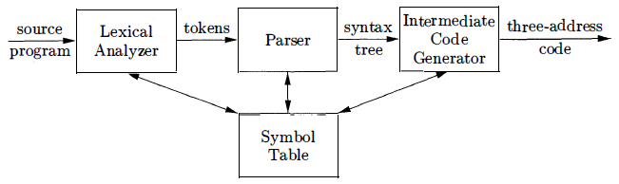
Syntax Directed Translation
Syntax-directed translation (SDT) is a method of translating a string into a sequence of actions by attaching one such action to each rule of a grammar.
The syntax-directed techniques can be used to construct compiler front ends.

Slide 19
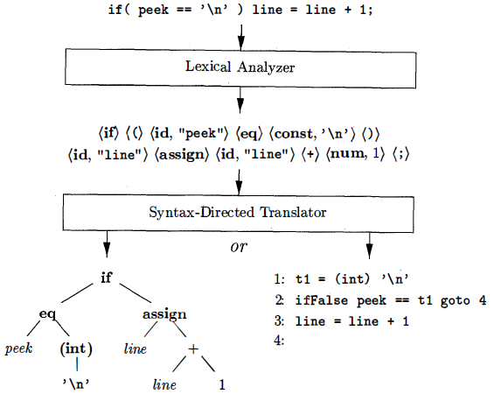
Syntax Directed Translator
Two possible translations of a statement

Slide 20
Syntax Directed Translator..
The starting point for a syntax-directed translator is a grammar for the source language.
A grammar describes the hierarchical structure of programs.
It is defined in terms of elementary symbols called terminals and variable symbols called non-terminals. These symbols represent language constructs.
The rules or productions of a grammar consist of a non-terminal called the head or left side of a production and a sequence of terminals and non-terminals called the body or right side of the production.
One non-terminal is designated as the start symbol

Slide 21
Attributes
In specifying a translator, it is helpful to attach attributes to programming construct where an attribute is any quantity associated with a construct.
Since constructs are represented by grammar symbols, the concept of attributes extends to grammar symbols.
Examples of attributes include
An integer value associated with a terminal num representing numbers
A string associated with a terminal id representing identifiers.

Slide 22
Lexical Analyzer
A lexical analyzer reads the input one character at a time and produces as output a stream of tokens, where a token consists of a terminal symbol along with additional information in the form of attribute values.
Tokens are written as tuples enclosed between ().
The token (id, "peek ") consists of the terminal id & a pointer to the symbol-table entry containing the string "peek" .
The translator uses the table to keep track of reserved words and identifiers.

Slide 23
Parsing
Parsing is the problem of figuring out how a string of terminals can be derived from the start symbol of the grammar by repeatedly replacing a non-terminal by the body of one of its productions.
Given a CFG a parse tree according to the grammar is a tree with the following properties:
The root is labeled by the start symbol.
Each leaf is labeled by a terminal or by ɛ.
Each interior node is labeled by a non-terminal.
If A → X1 X2 … Xn is a production, then node A has immediate children X1, X2, …, Xn where Xi is a (non)terminal or ε.

Slide 24
Parsing..
Parse tree of the string 9-5+2 using grammar G
list
list
digit
list
digit
digit
The sequence of leafs is called the yield of the parse tree
9
-
5
+
2

Slide 25
Parsing…
Conceptually, a parser builds a parse tree in which the root is labeled with the start symbol, each non-leaf corresponds to a production, and each leaf is labeled with a terminal or the empty string ɛ.
The parse tree derives the string of terminals at the leaves, read from left to right.
Efficient parsers can be built by hand, using a top-down method called predictive parsing.

Slide 26
Parsing...
A predictive parser has a procedure for each non-terminal:
Procedure bodies mimic the productions for non-terminals
The flow of control through the procedure bodies can be determined unambiguously by looking one symbol ahead in the input stream.
Syntax-directed translation is done by attaching either rules or program fragments to productions in a grammar.

Slide 27
Syntax Directed Definition
A syntax-directed definition attaches rules to productions, these rules are then used to compute attribute values.
A translation scheme embeds program fragments called semantic actions in production bodies.
The actions are executed in the order that productions are used during syntax analysis.

Slide 28
Intermediate Code
The result of syntax analysis is a representation of the source program, called intermediate code.
Two primary forms of intermediate code are
An abstract syntax tree has nodes for programming constructs, the children of a node give the meaningful sub constructs.
Alternatively, three-address code is a sequence of instructions in which each instruction carries out a single operation

Slide 29
Symbol Table
Symbol tables are data structures that hold information about identifiers.
Information is put into the symbol table when the declaration of an identifier is analyzed.
A semantic action gets information from the symbol table when the identifier is subsequently used.
Entries in the symbol table contain information about an identifier such as its character string (or lexeme) , its type, its position in storage, and any other relevant information.
The information is collected incrementally.

Slide 30
Lexical Analysis
Lexical analysis is the process of converting a sequence of characters into a sequence of tokens.
A program or function which performs lexical analysis is called a lexical analyzer, lexer or scanner.
A lexer often exists as a single function which is called by a parser or another function.

Slide 31
Lexical Analysis..
Typical tasks performed by lexical analyzer:
Remove white space and comments
Encode constants as tokens
Recognize keywords
Recognize identifiers and store identifier names in a global symbol table

Slide 32
Our Compiler Structure
Source
Program (Character stream)
Lexical analyzer
Syntax-directed translator
Token stream
Java bytecode
Develop parser and code generator for translator
Syntax definition (BNF grammar)
JVM specification

Slide 33
Tokens, Patterns & Lexemes
Tokens
The lexical analyzer scans the source program and produces as output a sequence of tokens, which are normally passed, one at a time to the parser.
Some tokens may consist only of a token name while others may also have an associated lexical value that gives information about the particular instance of the token that has been found on the input.
The token name is an abstract symbol representing a kind of lexical unit, e.g., a particular keyword, or sequence of input characters denoting an identifier.

Slide 34
Tokens, Patterns & Lexemes..
A pattern is a description of the form that the lexemes of a token may take.
In the case of a keyword as a token, the pattern is just the sequence of characters that form the keyword.
A lexeme is a sequence of characters in the source program that matches the pattern for a token and is identified by the lexical analyzer as an instance of that token.

Slide 35
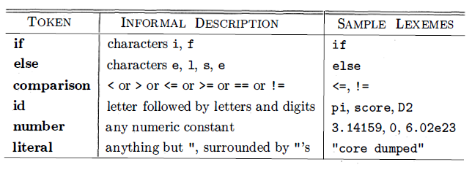
Tokens, Patterns & Lexemes…
In many programming languages, the following classes cover most or all of the tokens:

Slide 36
Tokens, Patterns & Lexemes..
For tokens corresponding to keywords, attributes are not needed since the name of the token tells everything.
But consider the token corresponding to integer constants. Just knowing that the we have a constant is not enough, subsequent stages of the compiler need to know the value of the constant.
Similarly for the token identifier we need to distinguish one identifier from another.
The normal method is for the attribute to specify the symbol table entry for this identifier.

Slide 37
Tokens, Patterns & Lexemes..
Ex. The token names and associated attribute values for the Fortran statement E = M * C² are as follows:
<id, pointer to symbol-table entry for E>
<assign_op>
<id, pointer to symbol-table entry for M>
<mult_op>
<id, pointer to symbol-table entry for C>
<exp_op>
<number, integer value 2>

Slide 38
Thank You

